Slide 1
DATA SENSING FROM SPACE
Srivatsan Madapuzi Srinivasan

Slide 2
01
Overview
Overview about the project
02
Data
Discuss about the data used
03
Findings & Managerial Recommendations
Discusses about the recommendations based on the findings.
CONTENTS

Slide 3
01
Overview
Satellite remote sensing offers a unique global observational platform for pursuing societal benefits in ways that are not feasible using only conventional ground-based approaches. Despite the abundant scientific output and remote sensing data emerging rapidly from satellite missions, we fail to convert them into actionable products that improve decision making process for social good. This is mainly due to the fact that the analysis of remote sensing data tends to perform by specially trained remote sensing analyst with specialized image analysis software.

Slide 4
02
Data
For the purpose of this study, Sentinal-2 L2A data acquired on 2018-02-10 will be used. Sentinel-2 carries the Multispectral Imager (MSI). This sensor delivers 13 spectral bands ranging from 10 to 60-meter pixel size. Its blue (B2), green (B3), red (B4), and near-infrared (B8) channels have a 10-meter resolution. Next, its red edge (B5), near-infrared NIR (B6, B7, and B8A), and short-wave infrared SWIR (B11 and B12) have a ground sampling distance of 20 meters. Finally, its coastal aerosol (B1), water vapour (B9) and cirrus band (B10) have a 60-meter pixel size.

Slide 5
2. DATA (contd..)

Slide 6
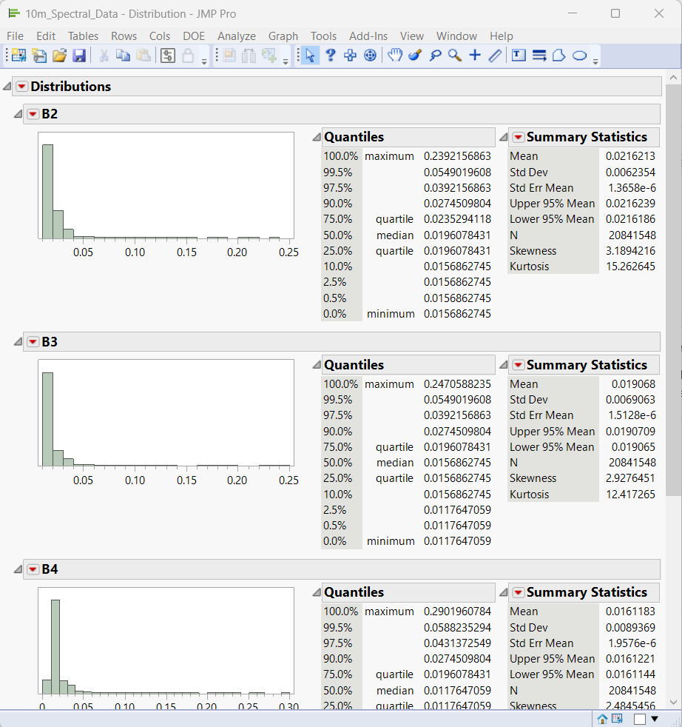
Findings & Recommendations
Data is highly skewed among the bands falling under the same resolution size.
It can be observed that all the spectral bands data are highly skewed.
This needs to be analysed and addressed why the reflection wavelengths of different bands differ a lot.
Fig-1 Distribution details of different bands.

Slide 7
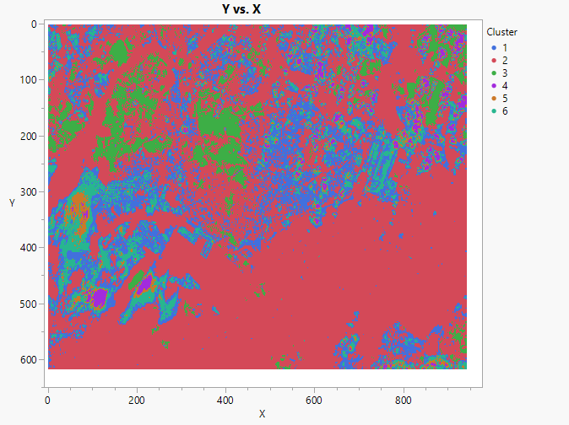
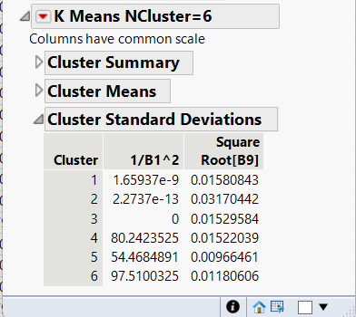
Findings & Recommendations (contd..)
Clustering performed on 60m Spectral Resolution
The clarity of the plotted Singapore map is very poor for 60m resolution data.
Standard deviation of the chosen optimal cluster is high.
Fig-2 60m cluster data on graph
Fig-3 Optimal Cluster Summary

Slide 8
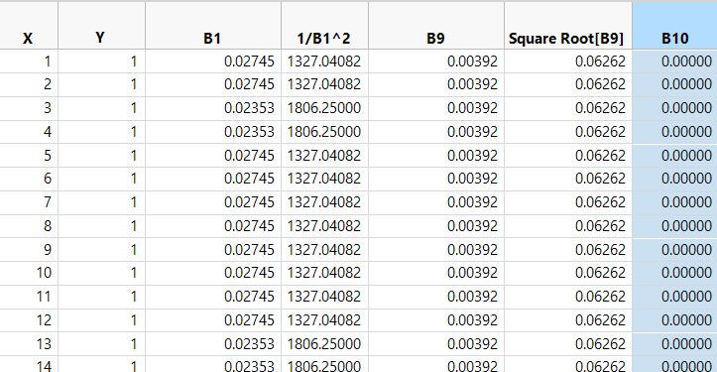
Findings & Recommendations (contd..)
Missing values for Band 10 in 60m Spectral Resolution
Band10 has only value zero.
Recommended Action: To check if there is a problem with the satellite device of Cirrus band (Band10) data.
Fig-4 60m Data Table

Slide 9
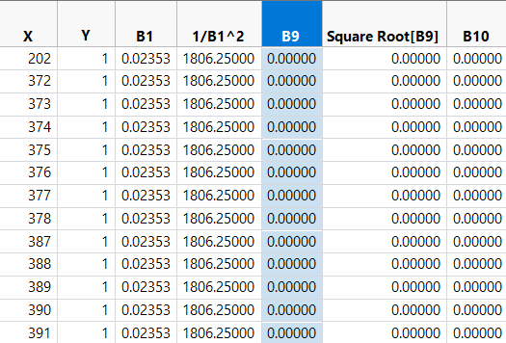
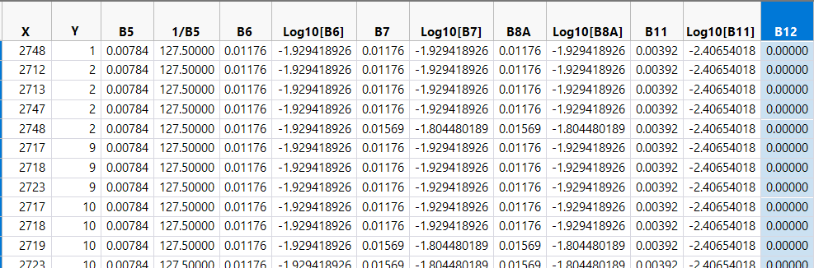
Findings & Recommendations (contd..)
The data needs to be more uniform; Band 9 and Band 12 have a lot of 0 values
Band9 and Band12 have a lot of zero values.
Suggests malfunction in the devices used to record the wavelengths of the above-mentioned bands. High attention in order to have a better data to perform further analysis.
Fig-4 60m Data Table
Fig-5 20m Data Table

Slide 10
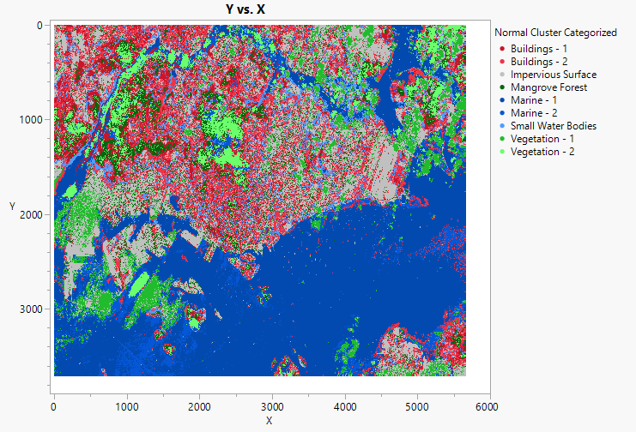
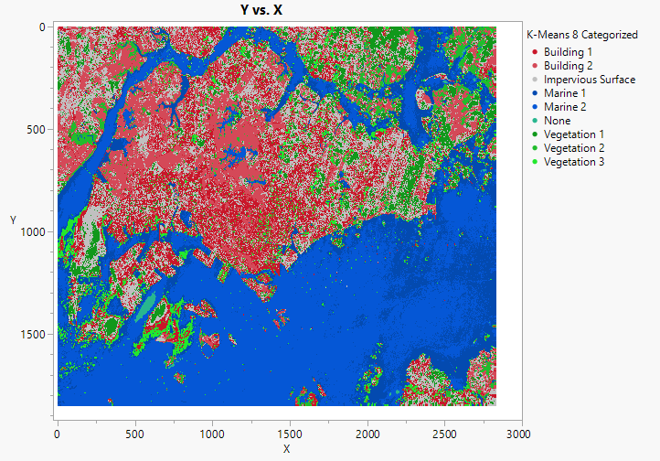
Findings & Recommendations (contd..)
Comparison between different spectral resolutions
Clarity of 10m Spectral data is better compared to the 20m Spectral data.
Recommended Action: To improve the 20m resolution data to improve the quality of reflection wavelength values.
Fig-7 10m Spectral Data clustered
Fig-8 20m Spectral data clustered

Slide 11
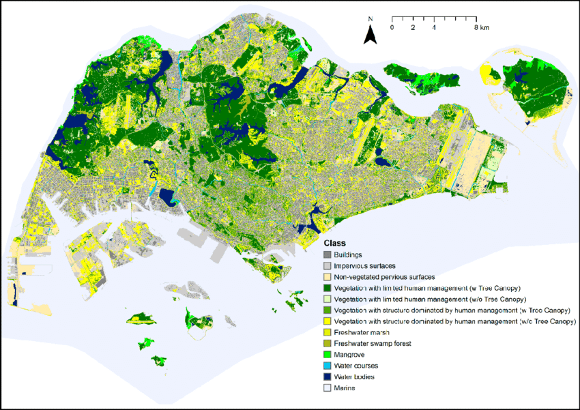
Findings & Recommendations (contd..)
Comparison of Singapore Map with older Singapore Satellite Images
Fig-9 10m Spectral Data clustered
Fig-10 2018 Singapore Satellite Image
Significant difference in the vegetation and forest areas between the maps.
Recommended Action: To introduce schemes to save the forests and other vegetation areas.

Slide 12
THANK YOU

